Slide 1
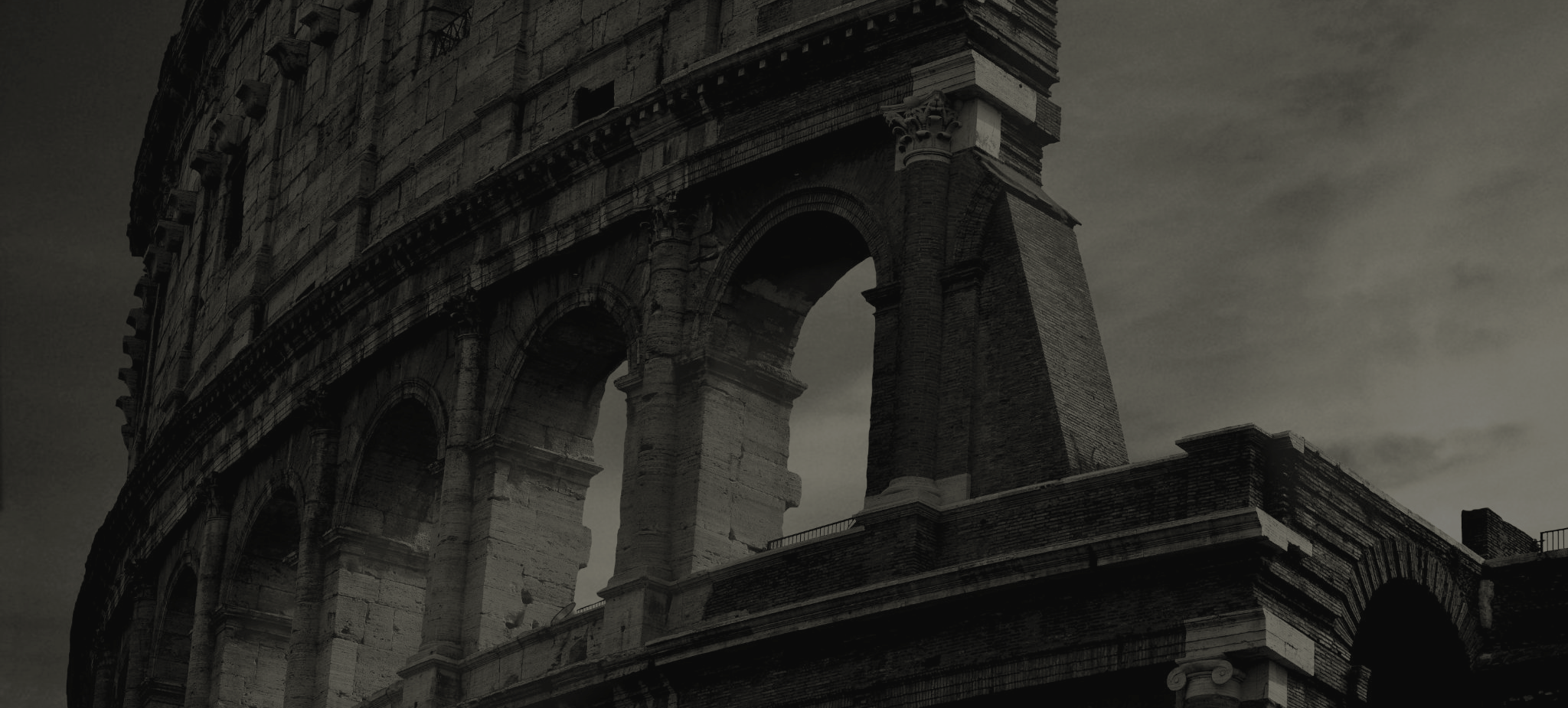
FAITHFUL THEN, FAITHFUL NOW
God’s Work throughout Church History

Slide 2
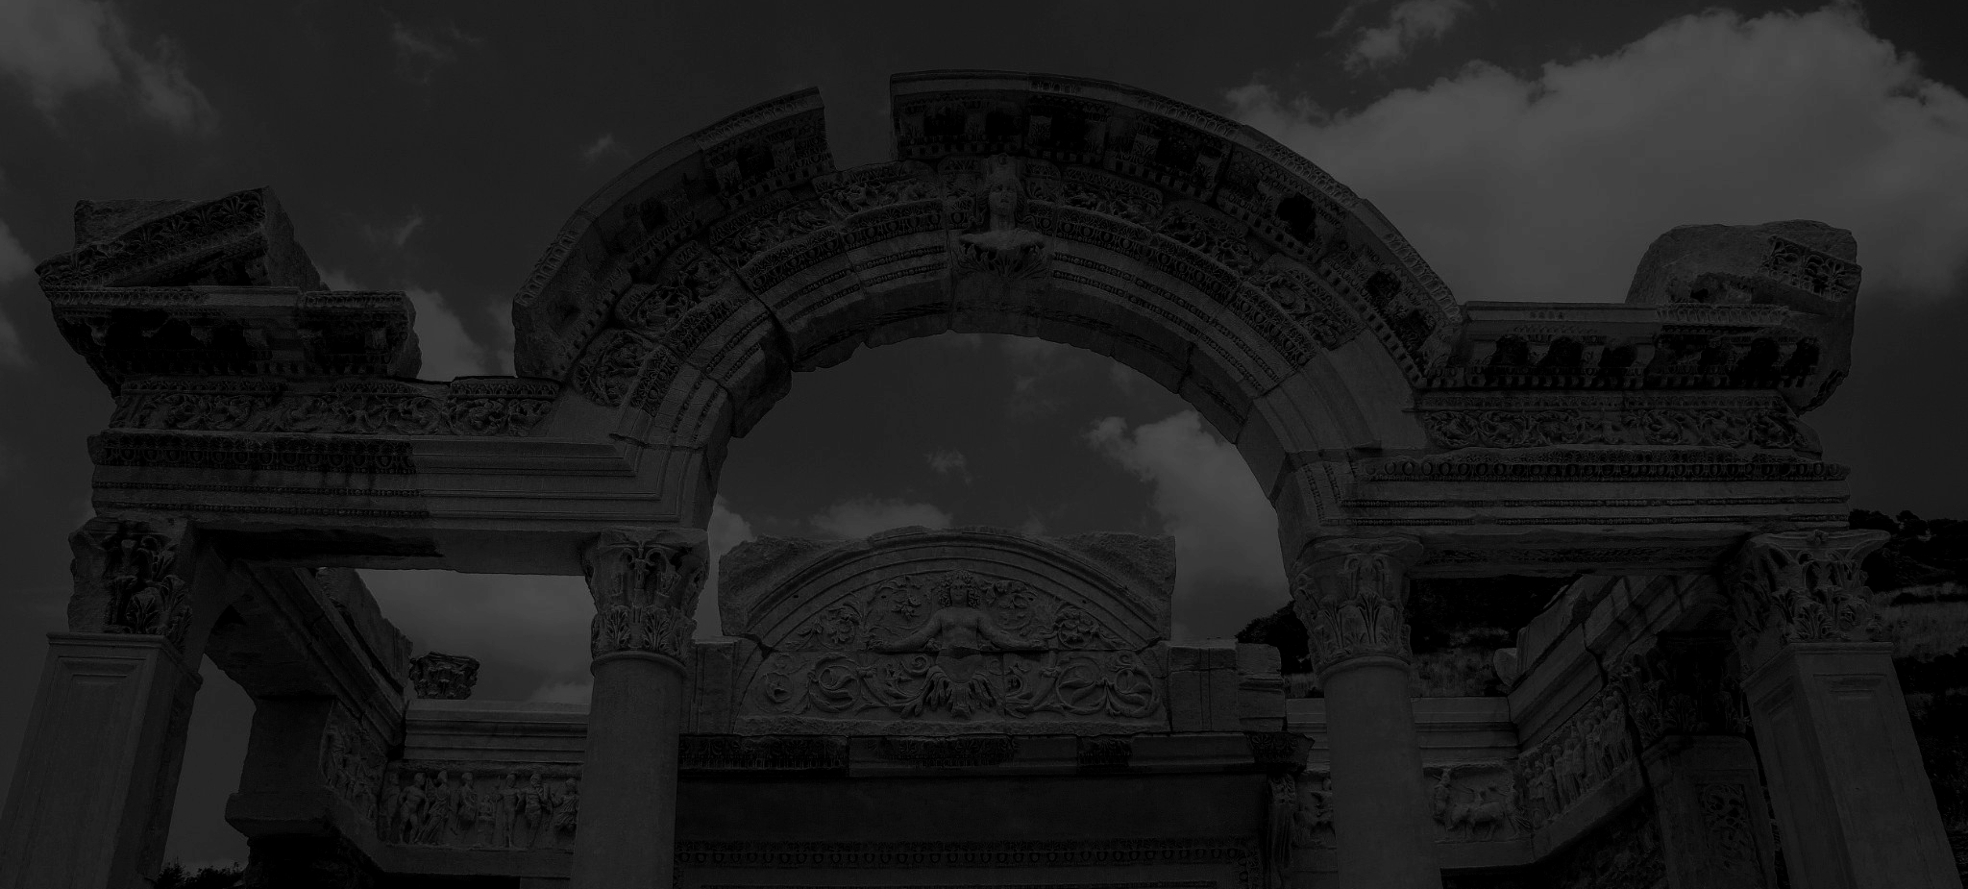
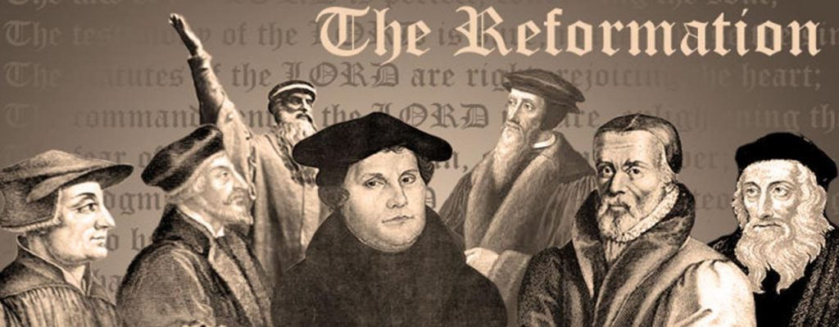
Post-Reformation Fallout
Who's in charge now?
God is always in control of world events and works all things together for good for those who are called according to his purpose.
Faithful Then, Faithful Now

Slide 3
Sola Scriptura
The Five Solas of the Reformation
Sola Fide
Sola Gratia
Sola Christus
Sola Deo Gloria
Faithful Then, Faithful Now

Slide 4
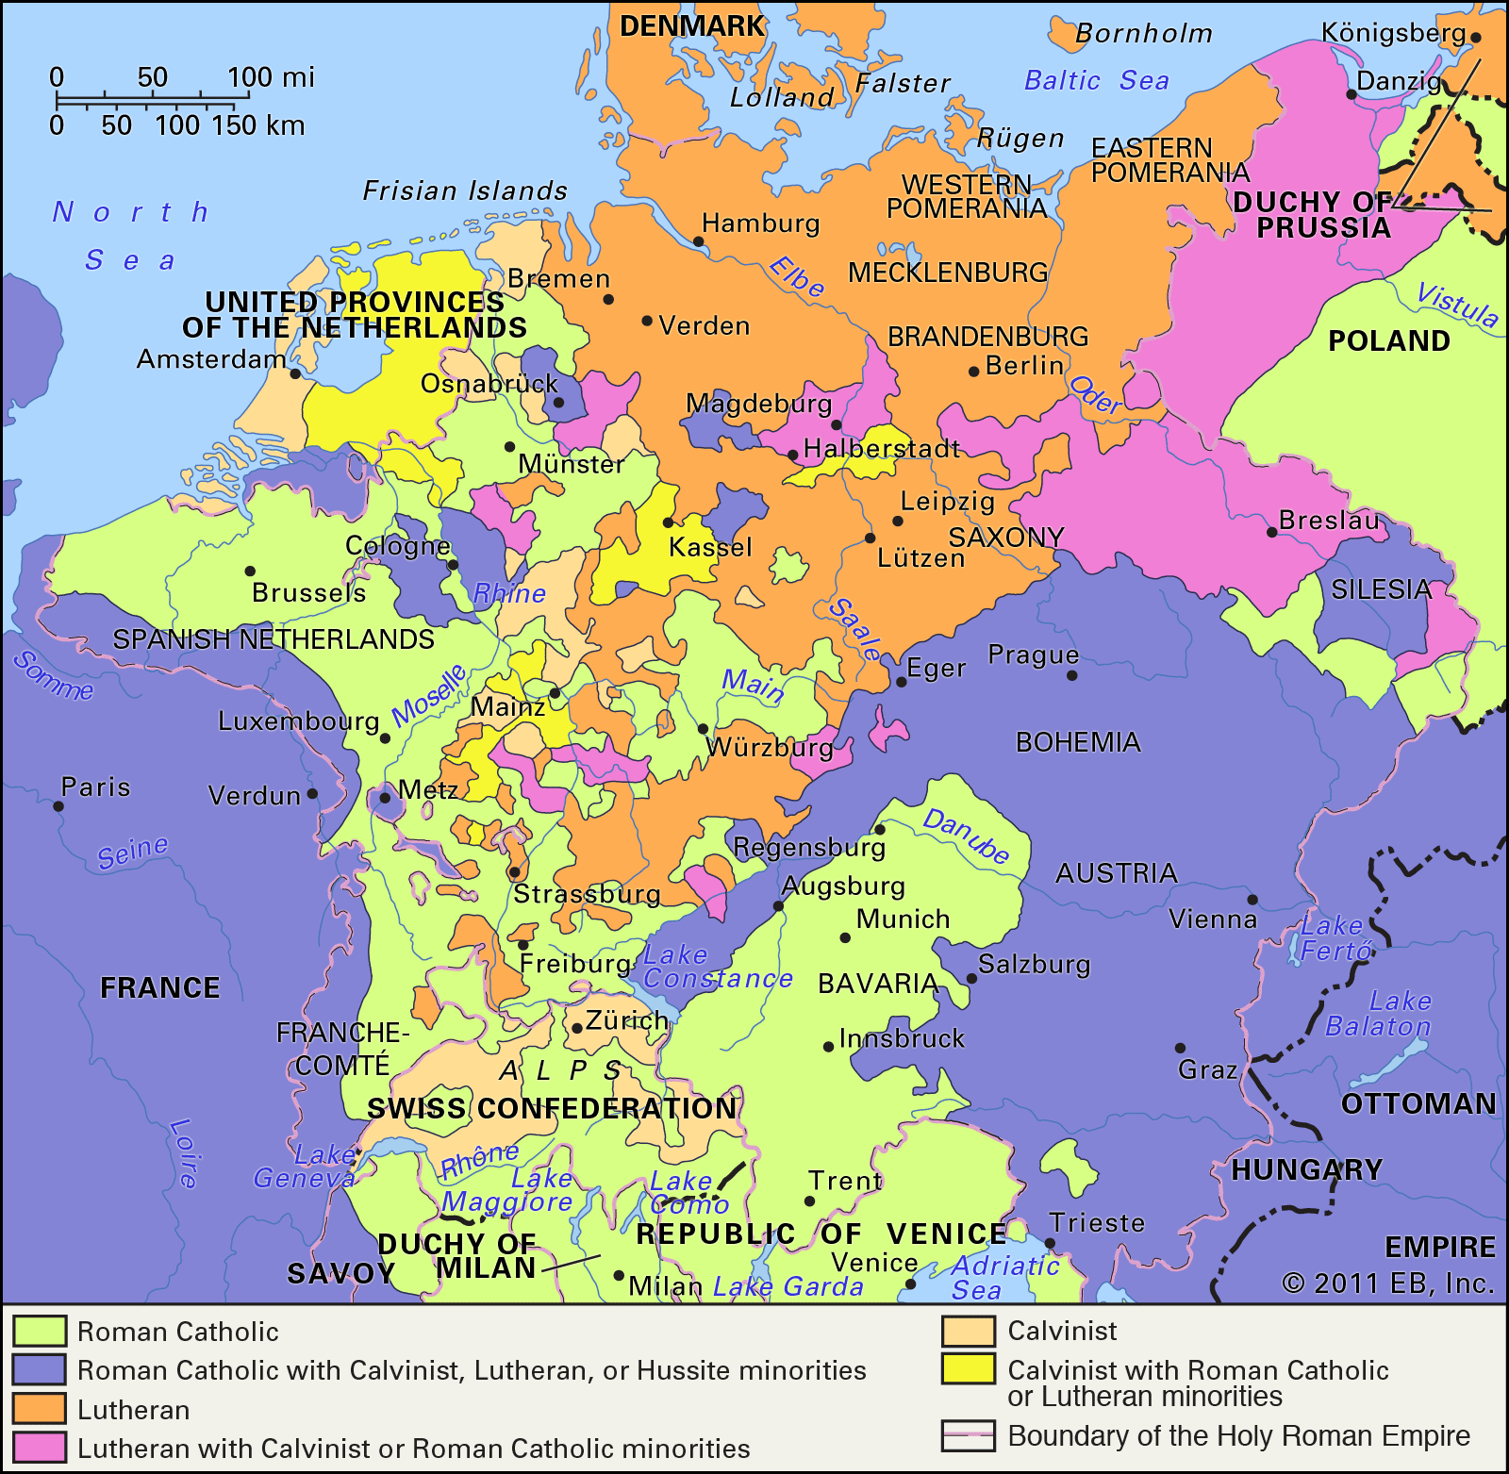
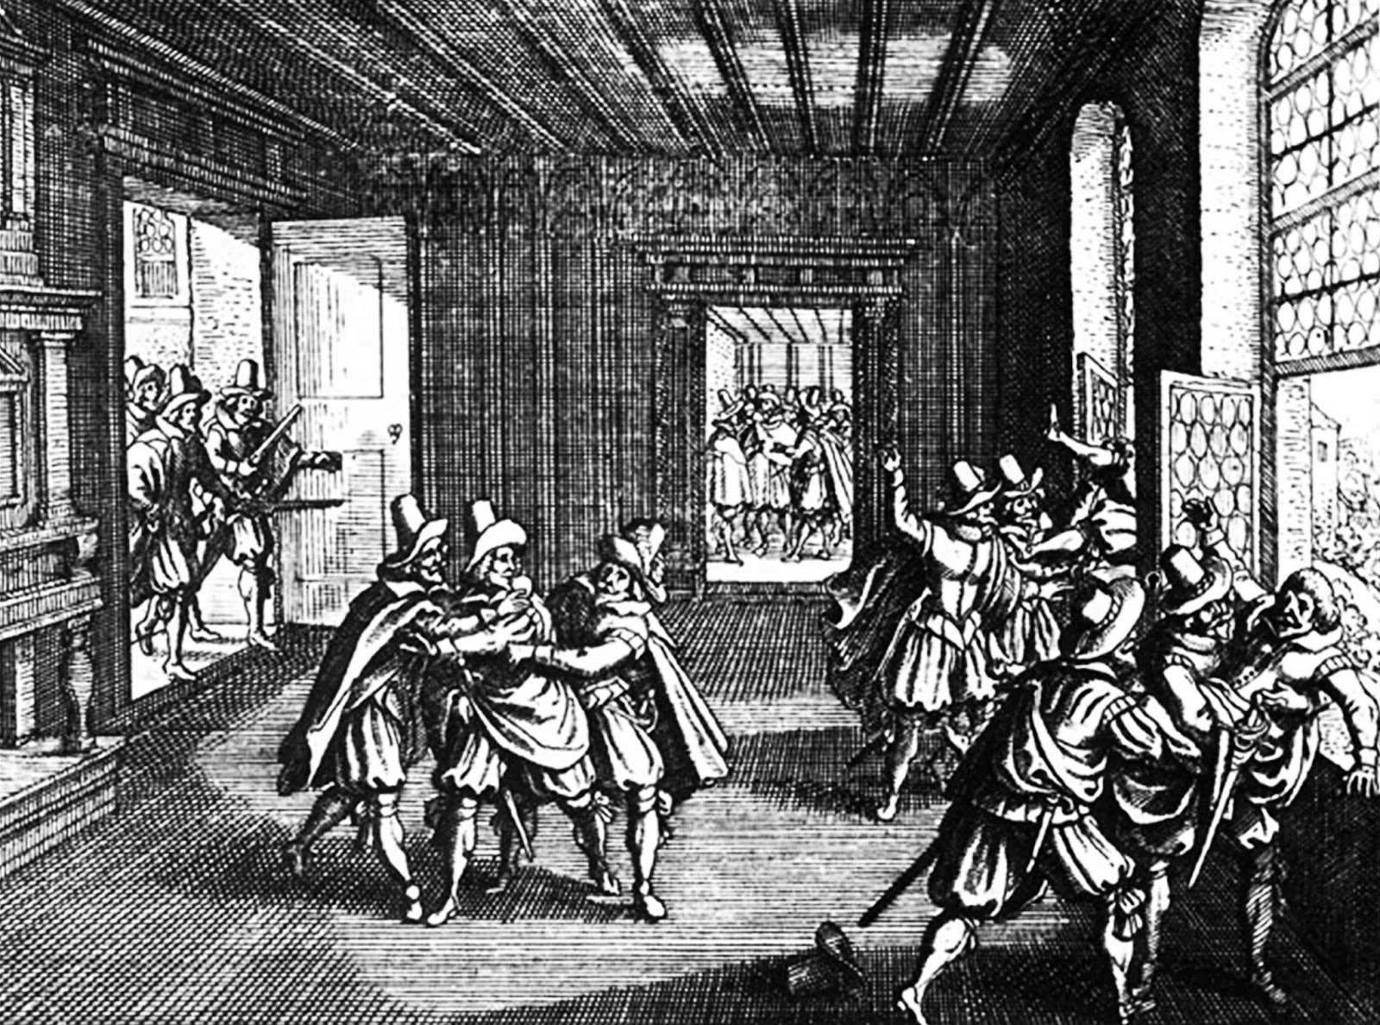
Thirty Years War
Faithful Then, Faithful Now

Slide 5
Post Reformation
Colloquy of Marburg with Luther and Zwingli (1529)
Calvin opens Geneva Academy (1559)
Mayflower lands in Plymouth (1620)
Luther posts 95 Theses (1517)
English Act of Supremacy (1534)
Defenestration of Prague, Beginning of the Thirty Years War (1618)
Peace of Westphalia, End of Thirty Years War (1648)
Faithful Then, Faithful Now

Slide 6
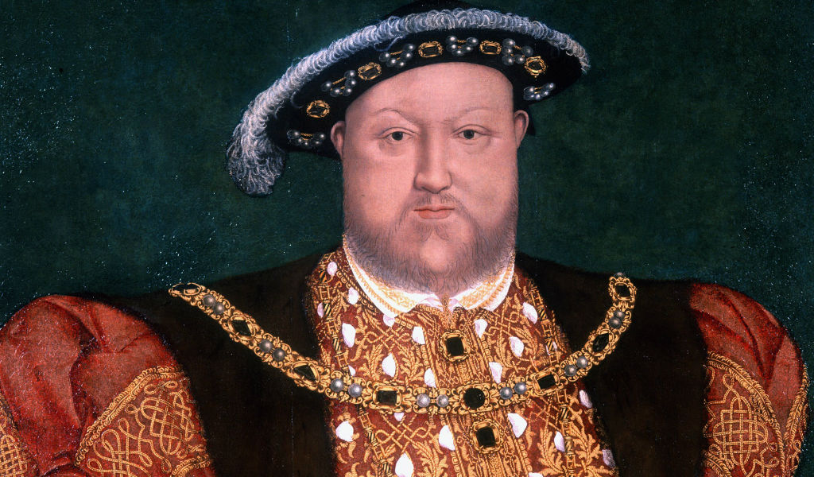
Henry VIII
Faithful Then, Faithful Now

Slide 7
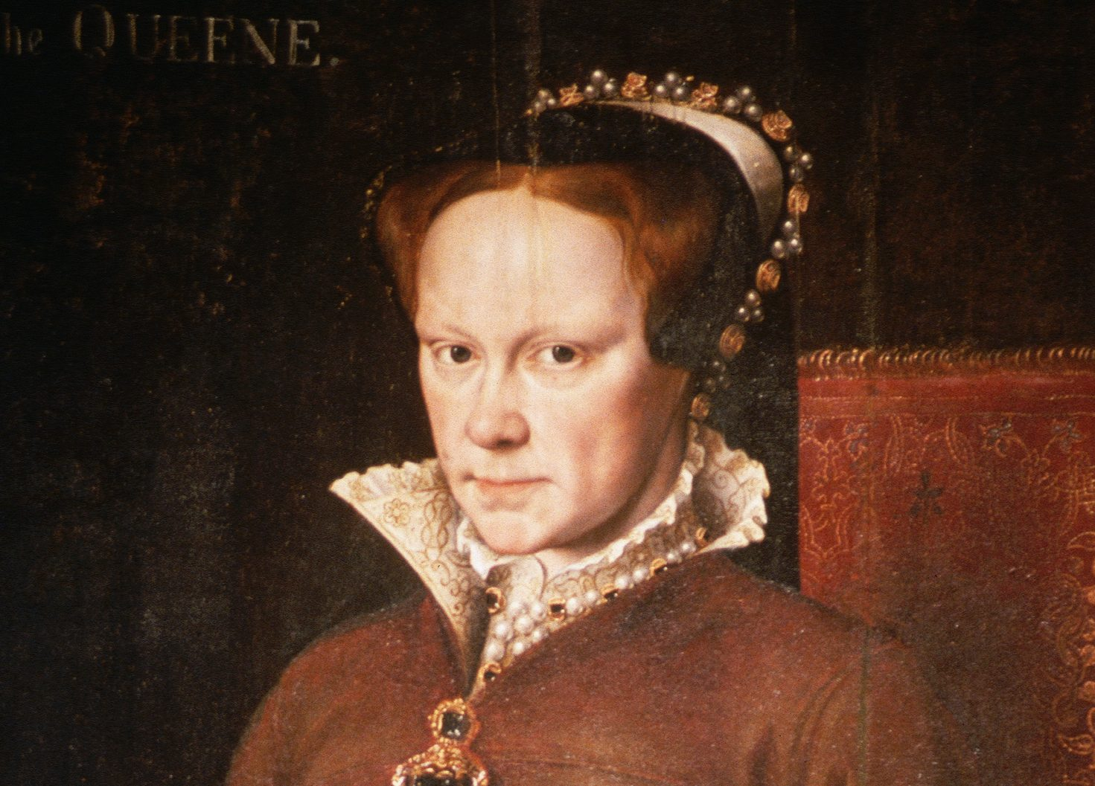
Mary I (Bloody Mary)
Faithful Then, Faithful Now

Slide 8
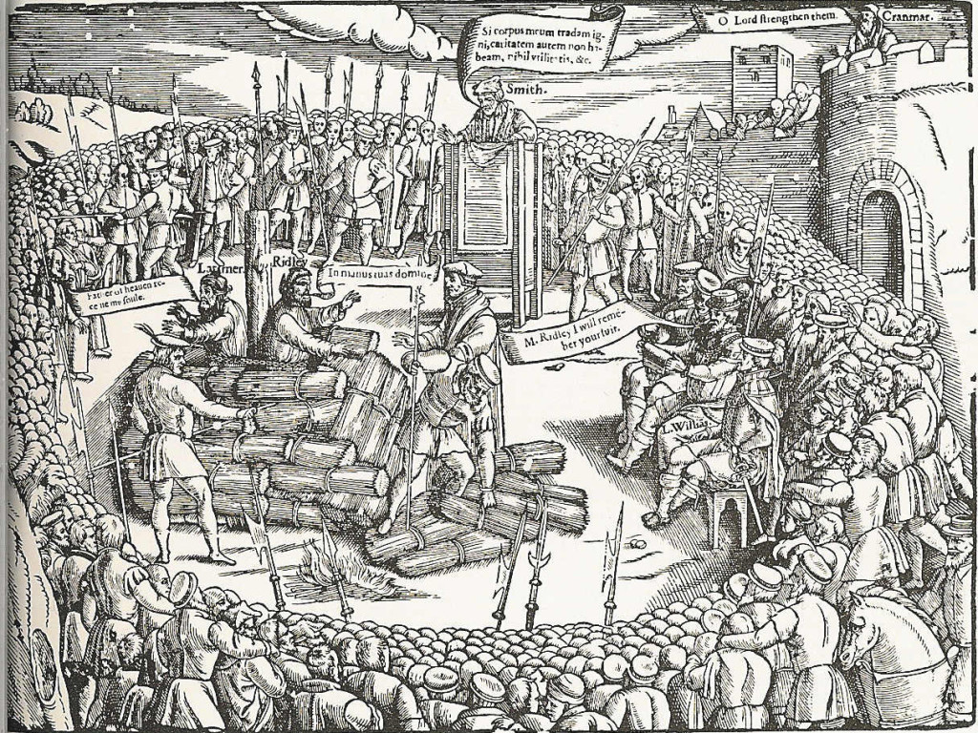
Hugh Latimer
“We shall to this day, by God’s grace, light such a candle in England as I trust shall never be put out.”
Faithful Then, Faithful Now

Slide 9
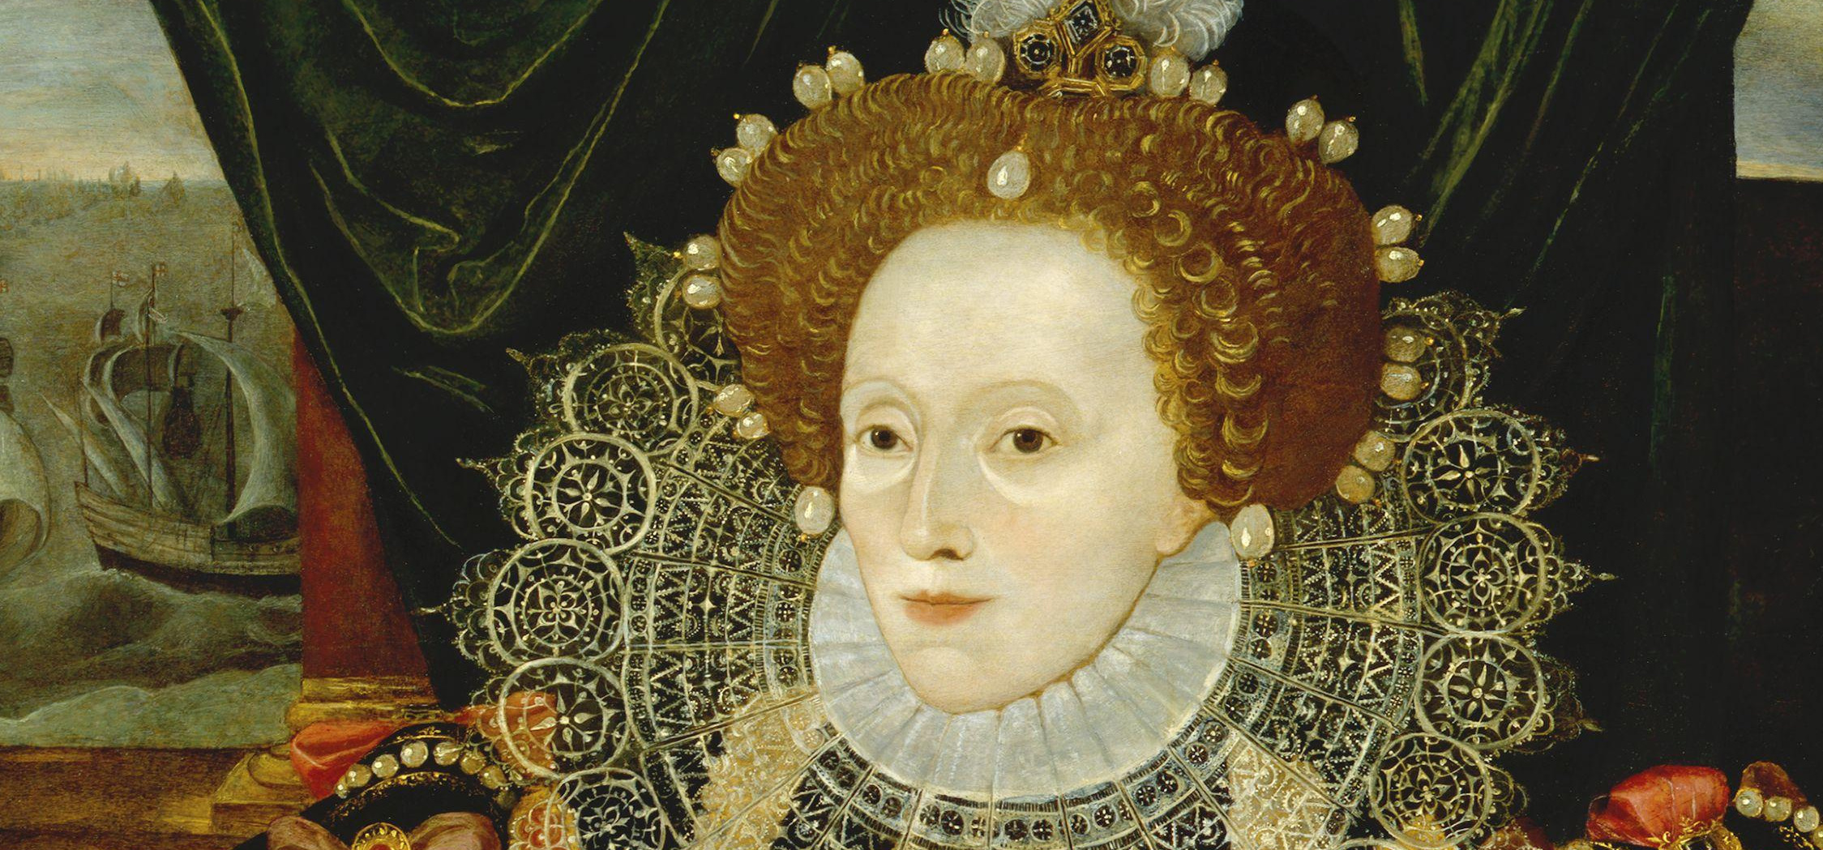
Elizabeth I
Faithful Then, Faithful Now

Slide 10
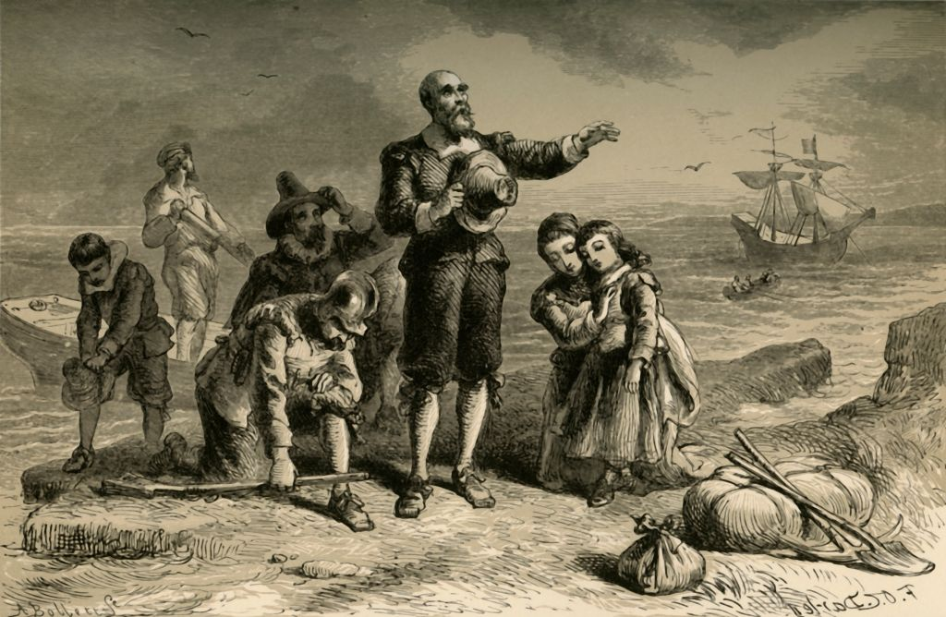
The Pilgrims
Faithful Then, Faithful Now

Slide 11
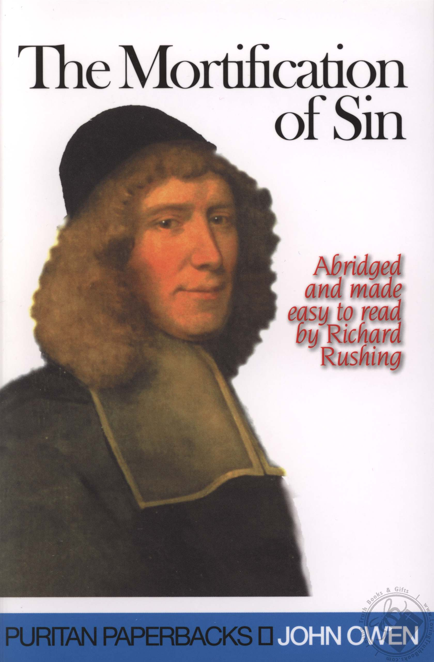
Suggested Puritan Titles
Mortification of Sin by John Owen
Pilgrim’s Progress by John Bunyan
Valley of Vision Collection of Puritan Prayers
Faithful Then, Faithful Now

Slide 12
FAITHFUL THEN, FAITHFUL NOW
God’s Work throughout Church History

