Slide 1
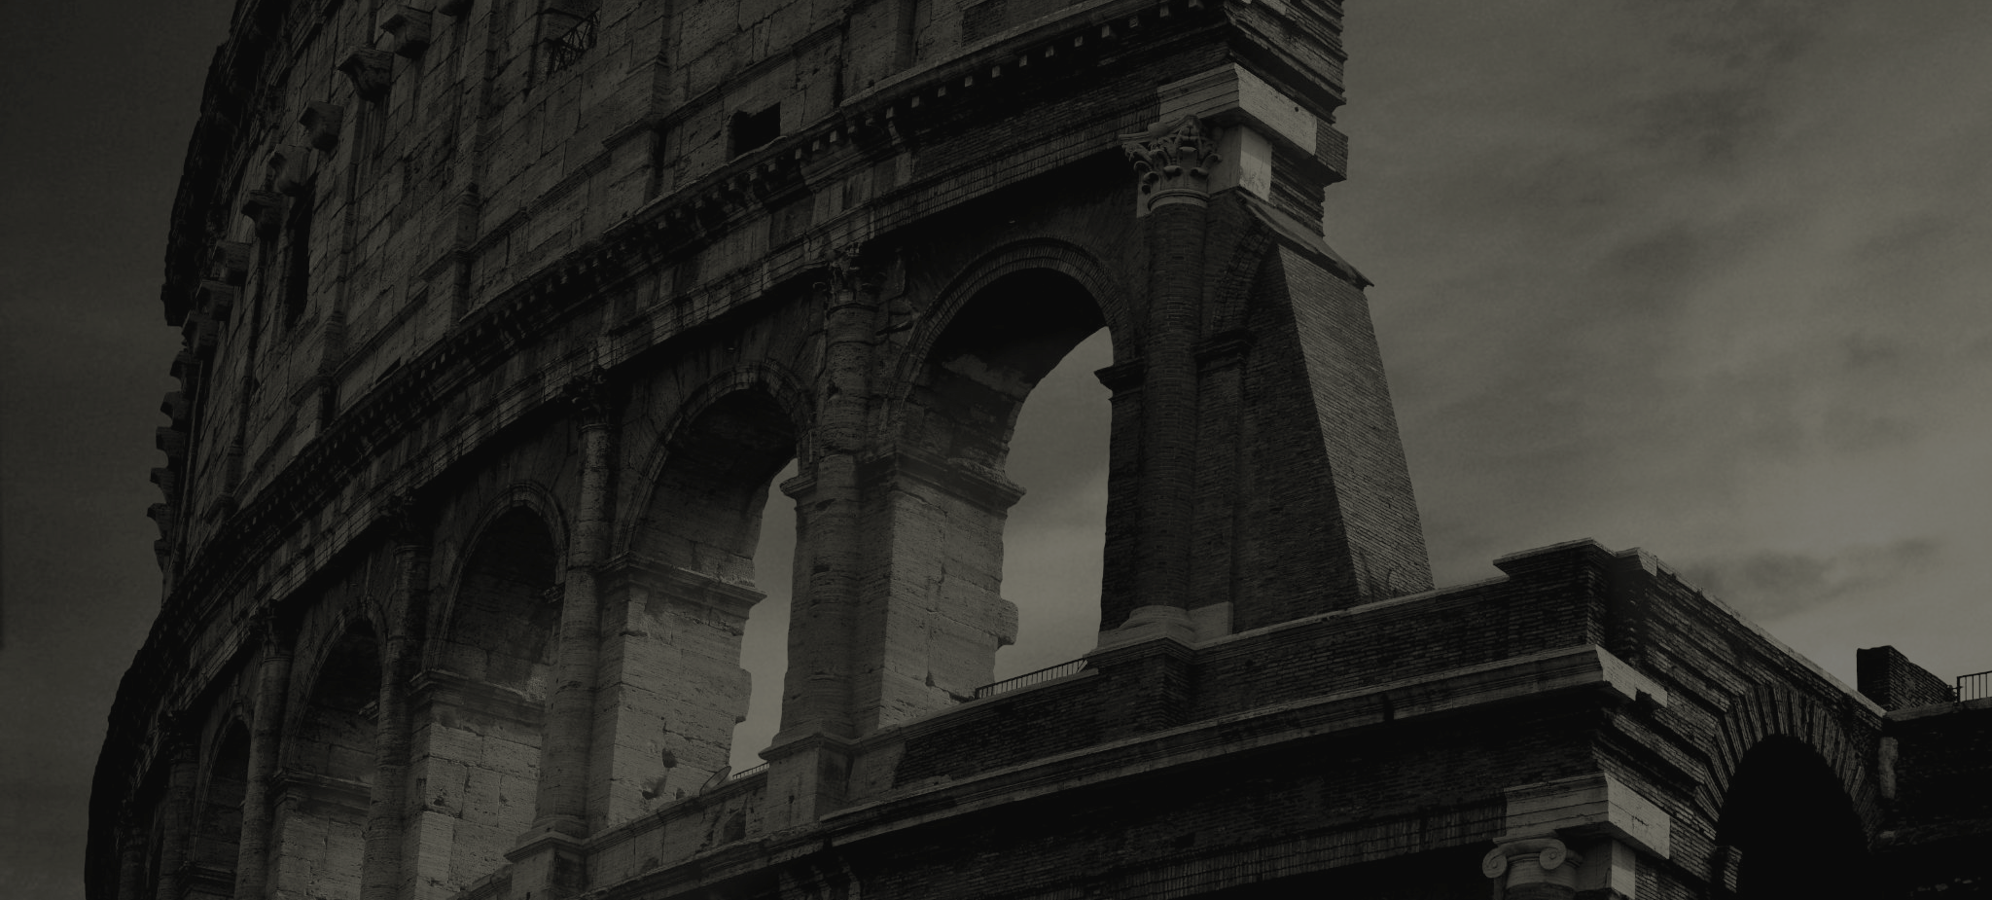
FAITHFUL THEN, FAITHFUL NOW
God’s Work throughout Church History

Slide 2
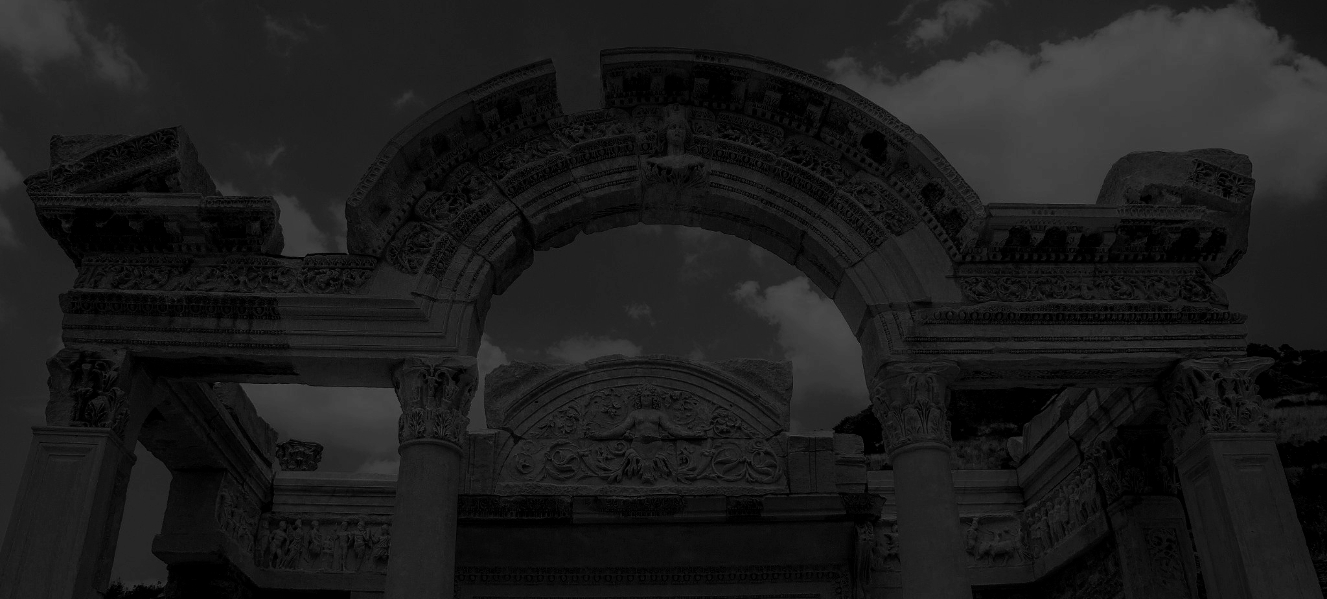
Roman Persecution
How is God faithful when the Church suffers?
Persecution purifies the church
God’s discipline is a sign of love
Persecution grew the church
Faithful Then, Faithful Now

Slide 3
Why Christians?
What made Christianity unique:
Not fully engaged in Roman Culture
Emphasized Love and Holiness
Rejected Gladiatorial combat
Treated women and the poor well
Refused to abandon newborns
Did not worship the emperor
Faithful Then, Faithful Now

Slide 4
Waves of Christian Persecution
______________________________________
Nero (54-68)
Domitian (81-96)
Trajan (108-117)
Marcus Aurelius
(161-180)
Septimius Severus (193-211)
Decius and Valerian (249-255)
Diocletian (284-305)
Accused Christians of burning Rome
Execution of Peter and Paul
Grouped Jews and Christians
John is exiled
No active pursuit of Christians but execute those who don’t worship the emperor.
Blames Antonine Plague on Christians
Martyrdoms of Polycarp and Justin Martyr
Wanted to unite empire under Sol Invictus
Martyrdom of Perpetua and Felicity
Brutal torture of Christians
Saints are maimed
The Church continues to thrive
Torture Christians instead of killing them
Martyrdoms of Cyprian and Origen
Faithful Then, Faithful Now

Slide 5
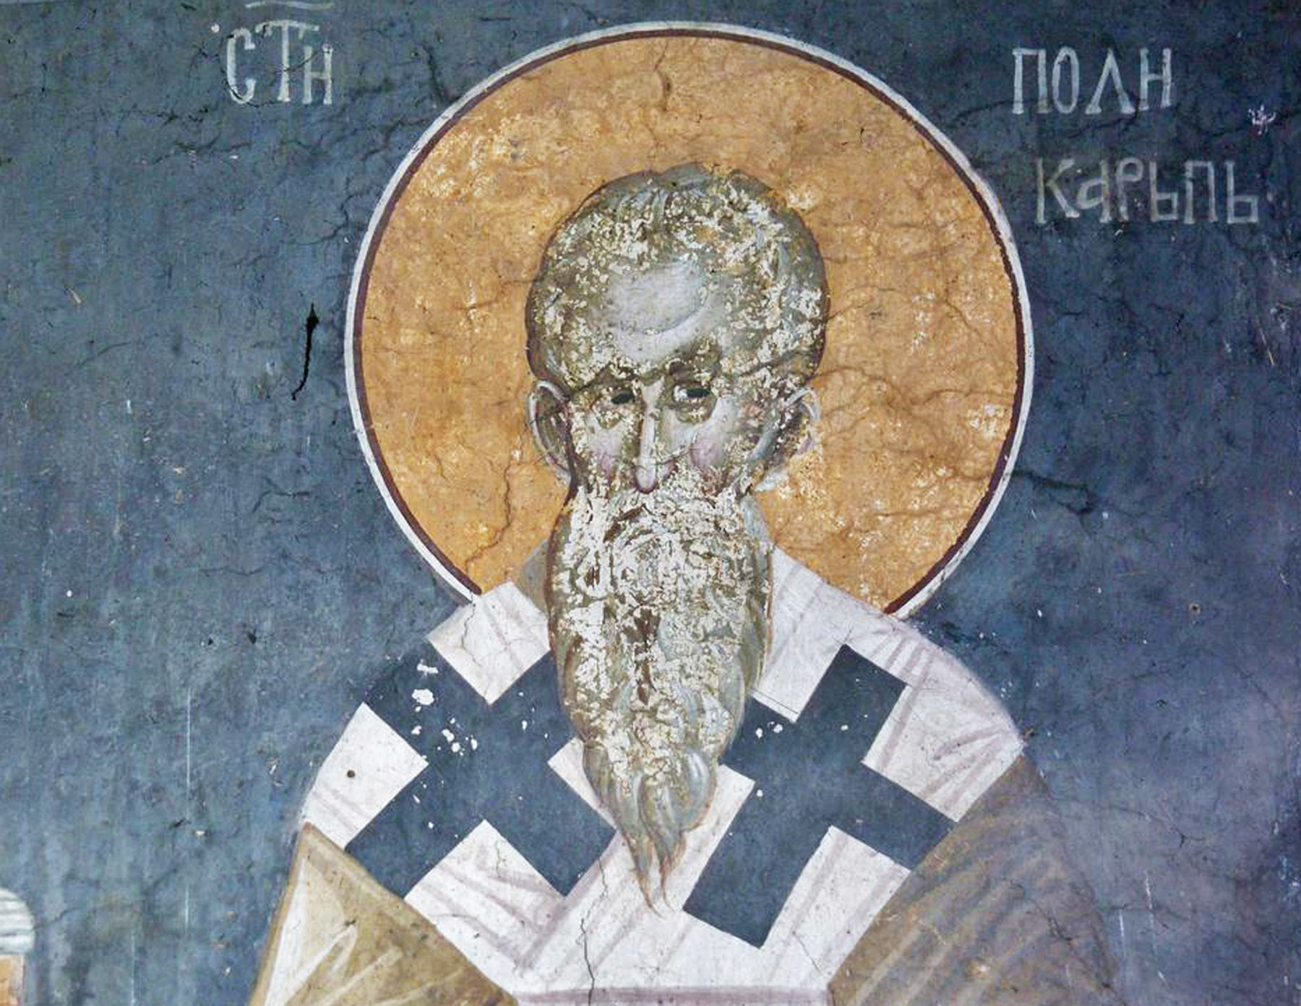
Polycarp
Faithful Then, Faithful Now

Slide 6
Waves of Christian Persecution
______________________________________
Nero (54-68)
Domitian (81-96)
Trajan (108-117)
Marcus Aurelius
(161-180)
Septimius Severus (193-211)
Decius and Valerian (249-255)
Diocletian (284-305)
Accused Christians of burning Rome
Execution of Peter and Paul
Grouped Jews and Christians
John is exiled
No active pursuit of Christians but execute those who don’t worship the emperor.
Blames Antonine Plague on Christians
Martyrdoms of Polycarp and Justin Martyr
Wanted to unite empire under Sol Invictus
Martyrdom of Perpetua and Felicity
Brutal torture of Christians
Saints are maimed
The Church continues to thrive
Torture Christians instead of killing them
Martyrdoms of Cyprian and Origen
Faithful Then, Faithful Now

Slide 7
FAITHFUL THEN, FAITHFUL NOW
God’s Work throughout Church History

