Slide 1
Textual Criticism
John 7:53-8:11
Adult Gospel Growth
January 2018

Slide 2
Textual Criticism
The intent of textual criticism is to ascertain which of the thousands of ancient manuscripts contain the original words that the New Testament writers dutifully penned under the inspiration of the Holy Spirit.

Slide 3
Revelation – the action of God in making Himself and His truth known
Inspiration – the action of God whereby he enabled men to make a true and accurate record of His revelation.
Canonization – the process by which believers recognized the characteristics qualifying particular books as the inspired Word of God.
Translation – the act of changing a communication from one language to another.
Interpretation – the unfolding of meaning such that God’s intended message is understood.
Textual criticism

Slide 5
AUTHOR | BOOK | DATE WRITTEN | EARLIEST COPIES | TIME GAP | NO. OF COPIES
Homer | Iliad | 800 B.C. | c. 400 B.C. | c. 400 yrs. | 643
Herodotus | History | 480-425 B.C. | c. A.D. 900 | c. 1350 yrs. | 8
Thucydides | History | 460-400 B.C. | c. A.D. 900 | C 1300 yrs. | 8
Plato |  | 400 B.C. | c. A.D. 900 | c. 1300 yrs. | 7
Demosthenes |  | 300 B.C. | C A.D. 1100 | c. 1400 yrs. | 200
Caesar | Gallic Wars | 100-44 B.C. | c. A.D. 900 | c. 1000 yrs. | 10
Livy | History of Rome | 59B.C. – A.D. 17 | 4th cent. (partial) mostly 10th cent. | c. 400 yrs. c. 1000 yrs. | 1 partial 19
Tacitus | Annals | A.D. 100 | c. A.D. 1100 | c. 1000 yrs. | 20
Pliny Secundus | Natural History | A.D. 61-113 | c. A.D. 850 | c. 750 | 7
New Testament |  | A.D. 50-100 | c. 114 (fragment) c. 200 (books) c. 250 (most of N.T.) c. 325 (complete N.T.) | 50 yrs. 100 yrs. 150 yrs. 225 yrs. | 5800+

Slide 7
Manuscripts are described in terms of…
Material they are made from
Their form
Their completeness
Their style of writing

Slide 8
Manuscripts are classified by…
Age
Geography
Relationship

Slide 9

Vulgate
Byzantine
Alexandrian
Old Latins
Western
Caesarean

Slide 10
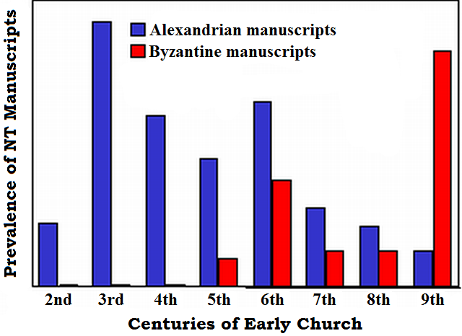

Slide 11
Eclectic Text – based on the use of all the manuscripts and text types. It reflects a broader textual base and rests on the theory that the date and quality of manuscripts is more important than the number of manuscripts
Majority Text – first published in 1982 based on the Byzantine text type and edited by Zane Hodges. It represents some 4000 manuscripts
Textus Receptus – given the title in the 1633 version of the Greek text edited and first published by Erasmus in 1516

Slide 12
Use of all manuscripts and text types
Eclectic Text UBS 5th ed. NA 28th ed.
NIV, ESV, NASB, NLT, RSV, etc.
Byzantine text type manuscripts
Majority Text Farstad & Hodges ed.
English Majority Text Version
6-7 Greek manuscripts available at Basil
King James & New King James Version
Textus Receptus

Slide 13
Internal Evidence
The placement of the passage disrupts the flow of thought in this section
The word “again” (8:12)
The allusion to (Is 9:1-2) connecting to (John 7:52)
Different locations of story in various manuscripts
Vocabulary and style that seem non-Johannine

Slide 14
External Evidence
The earliest and most reliable manuscripts from a variety of textual traditions omit this section
Many of the most significant early translations of the Scriptures into other languages also omit this section
None of the early Greek church fathers – even those who dealt with the text of John verse by verse – commented on this passage
Some church fathers like Augustine, tried to explain the absence of this text from the best manuscripts

Slide 15
Most likely a historical event
Most likely not a canonical account
Some call it a “text on probation”
Some preach sermons from the text while cross checking theology and principles with other passages. Some don’t.
We must deal with the truth behind this pericope or we undercut our confidence in the Bible.
This is not a modern versions issue – it is a textual critical issue.

