Slide 1
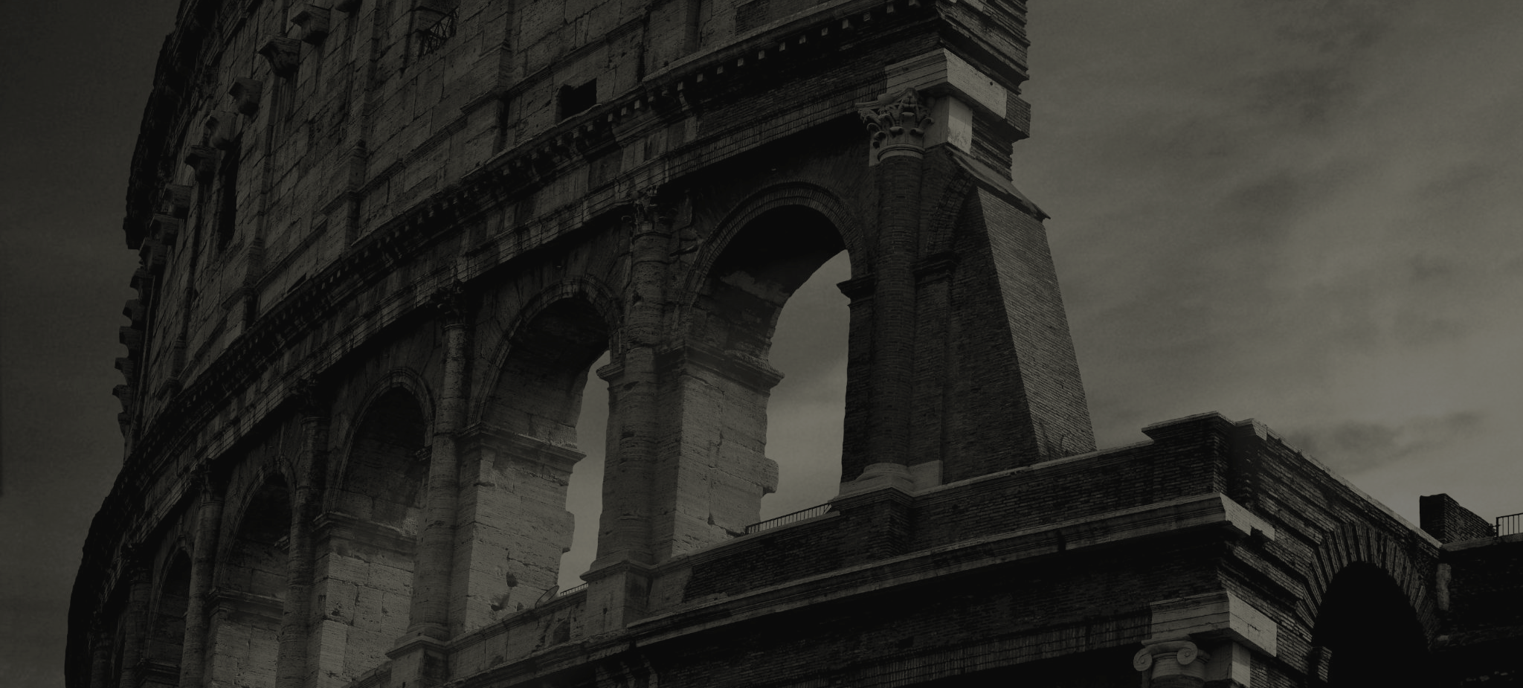
FAITHFUL THEN, FAITHFUL NOW
God’s Work throughout Church History

Slide 2
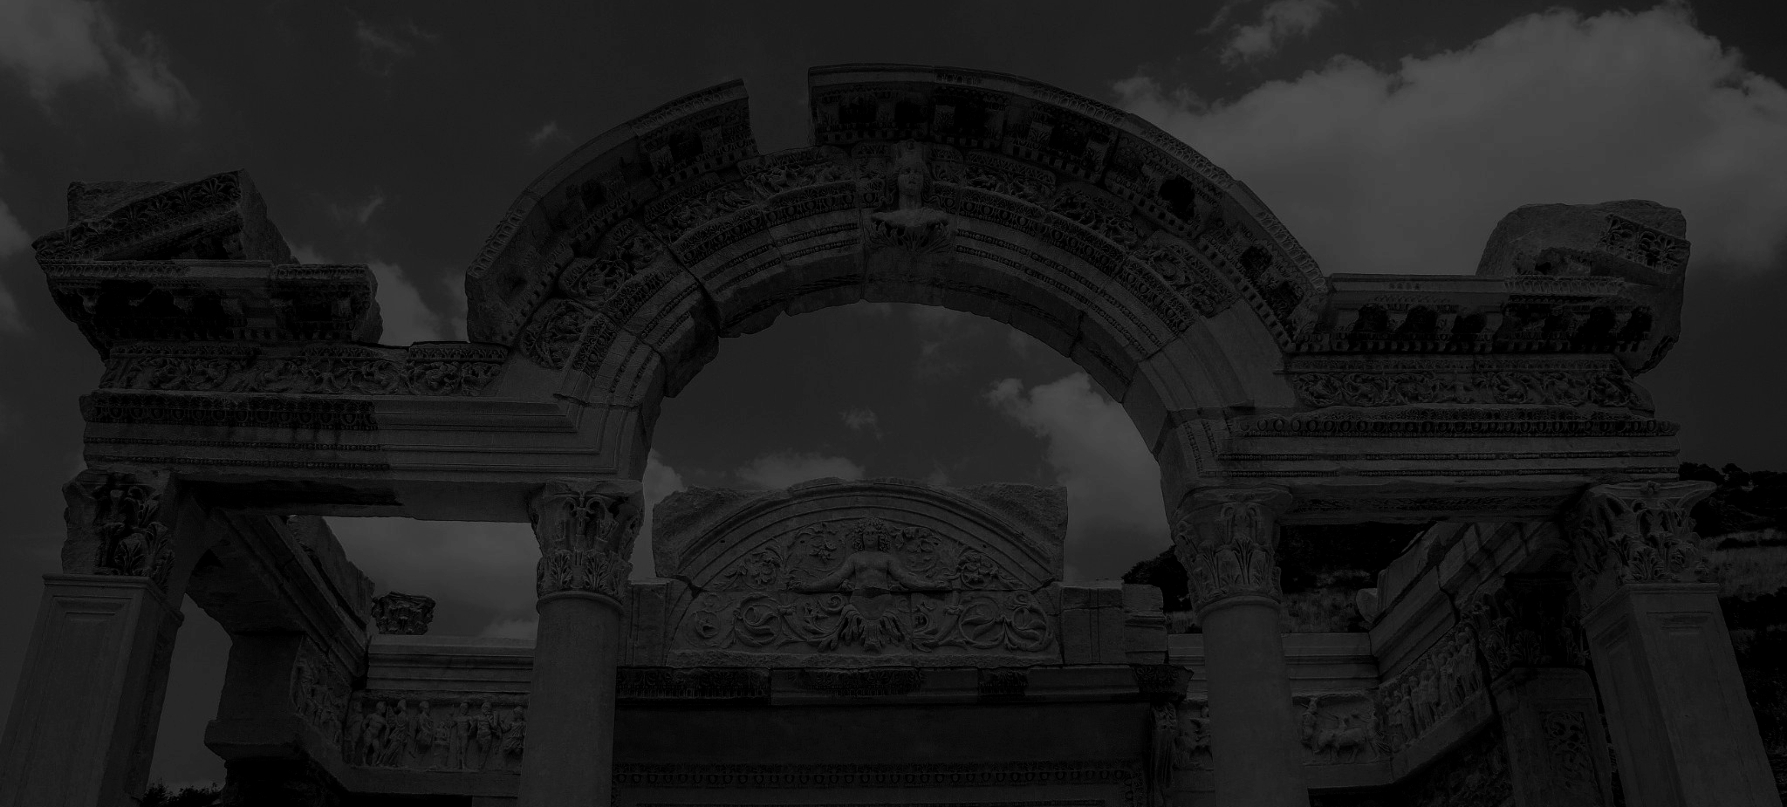
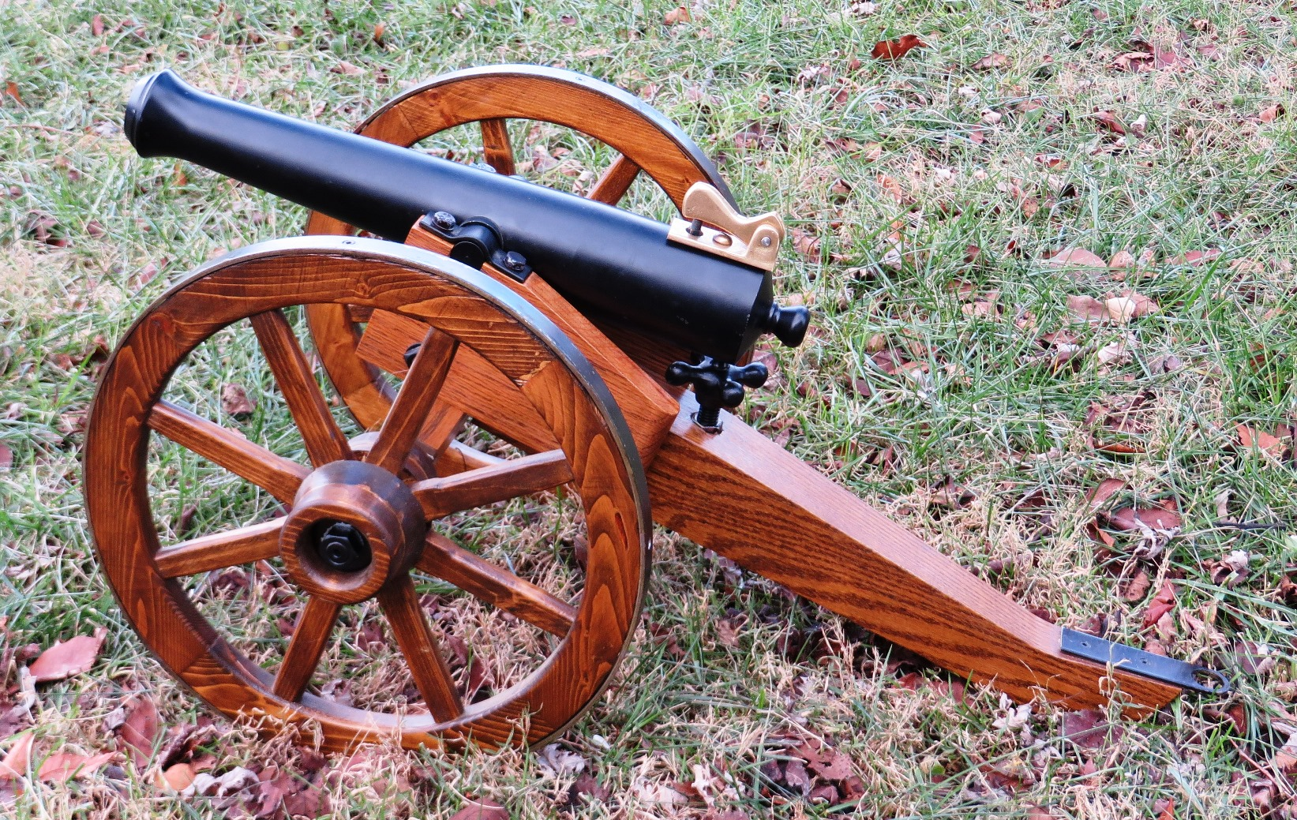
Creeds, Canon, Councils
Can the church stay united despite inner turmoil?
YES! Commitment to the Word of God keeps the Church unified in orthodoxy.
Faithful Then, Faithful Now

Slide 3
Kurt Eichenwald
To understand how what we call the Bible was made, you must see how the beliefs that became part of Christian orthodoxy were pushed into it by the Holy Roman Empire. By the fifth century, the political and theological councils voted on which of the many Gospels in circulation were to make up the New Testament. With the power of Rome behind them, the practitioners of this proclaimed orthodoxy wiped out other sects and tried to destroy every copy of their Gospels and other writings.
Newsweek Article, “The Bible, So Misunderstood It’s a Sin.” 12/23/14
Faithful Then, Faithful Now

Slide 4
Bart Ehrman
[The early church had] lots of other gospels, acts, epistles and apocalypses having very different perspectives from those found in the books that eventually came to be called the New Testament… All these groups claimed to be Christian, insisting that their views were true and had been taught by Jesus and his followers… The group that established itself as ‘orthodox’ (as always in quotation marks) then determined what future Christian generations would believe and read as scripture…Only one group eventually ‘won out’ in these debates. It was this group that decided what the Christian creeds would be…this was the group that decided which books would be included in the canon of scripture.
From, Misquoting Jesus, 152-154.
Faithful Then, Faithful Now

Slide 5
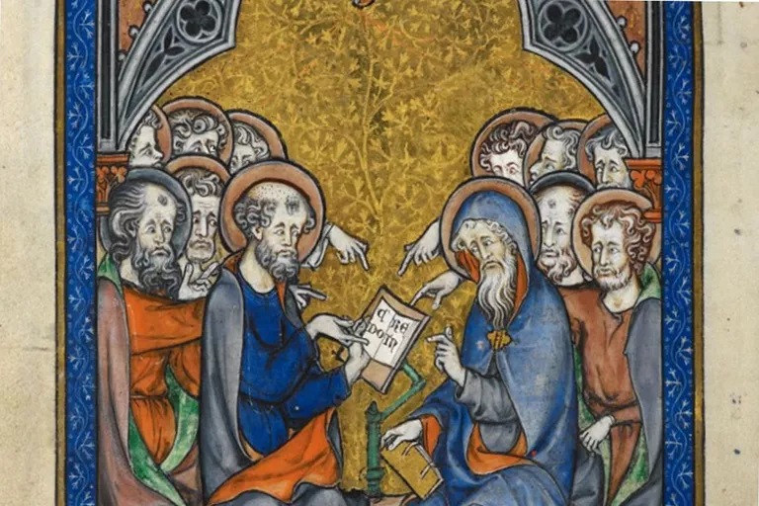
Creeds
Statements of Belief
Connected to Baptism
Some found in the Bible itself
Ignatius, Irenaeus, and Tertullian
Creed of Nicaea, Nicene Creed, Apostles Creed
“The Apostles Composing the Creed” by Somme le Roy – Public Domain
Faithful Then, Faithful Now

Slide 6
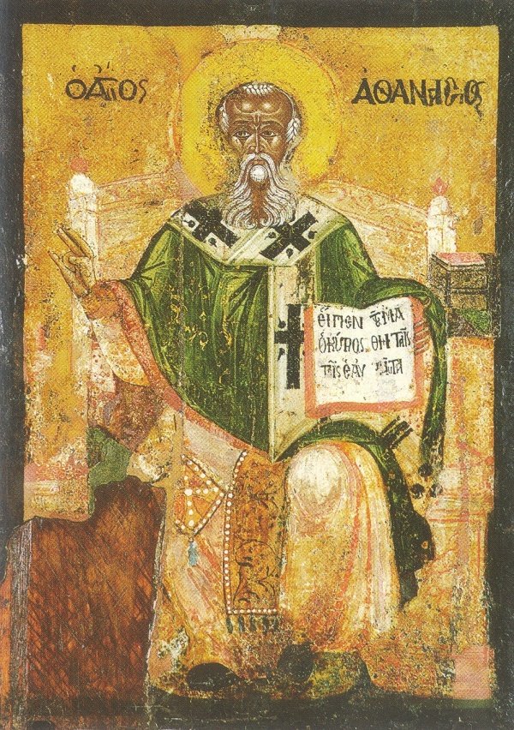
Canon
Collection of Books Regarded as Scripture
OT Canon was established by first century
Early Consensus on Gospels and Epistles
Marcion forces the Church to clarify
Athanasius articulates what was accepted
Faithful Then, Faithful Now

Slide 7
Apostolicity
Requirements That Define Canon
Antiquity
What did the writing need to show in order to be accepted as Scripture:
Orthodoxy
Catholicity
Traditionality
Spirituality
Faithful Then, Faithful Now

Slide 8
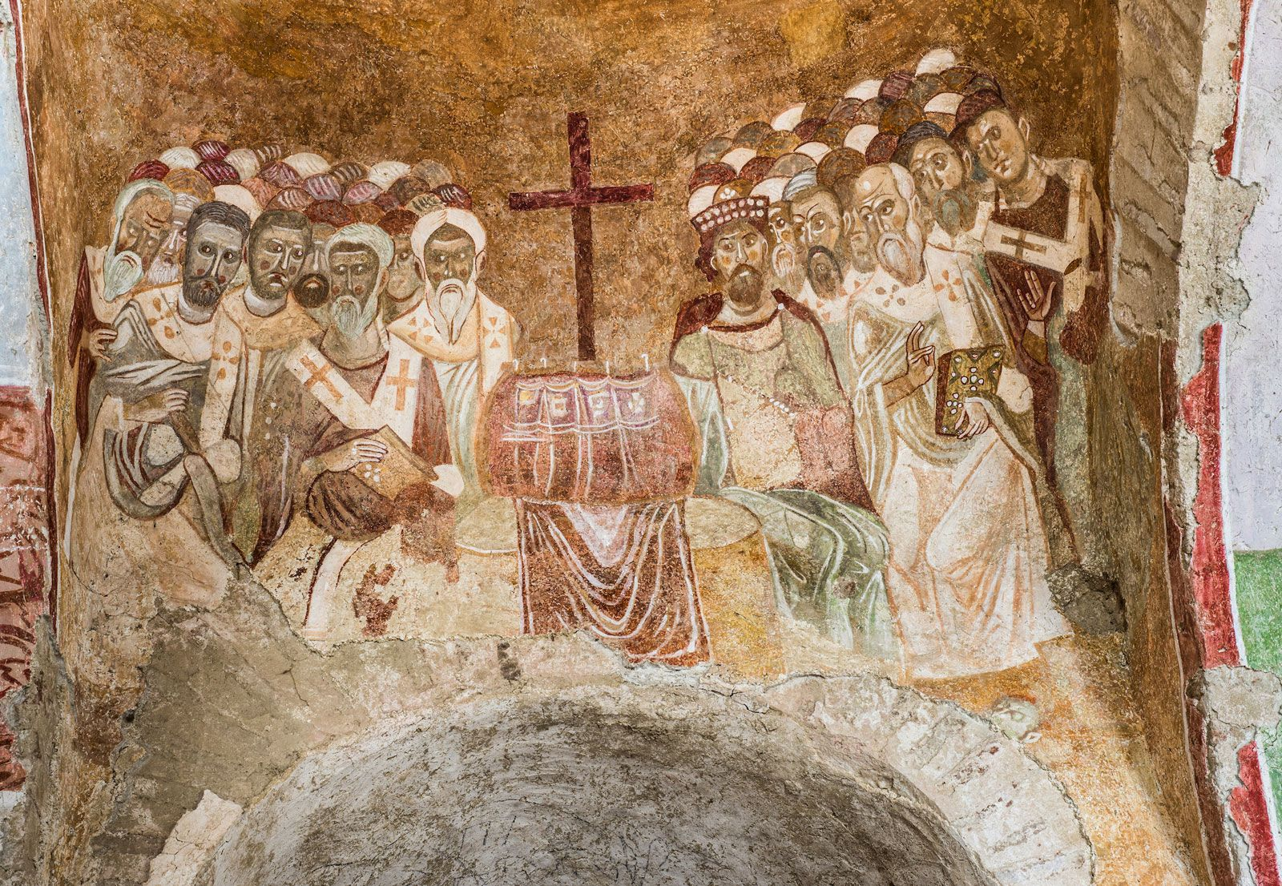
Councils
Ecumenical Meetings that Clarified Doctrine
Constantine makes Christianity legal, calls Council of Nicaea in 325
Council condemns Arianism, declares Creed of Nicaea
Only three attendees don’t sign
Byzantine Fresco of the Council of Nicaea from the Basilica of Saint Nicholas in modern Demre, Turkey
-From Encyclopedia Britannica
Faithful Then, Faithful Now

Slide 9
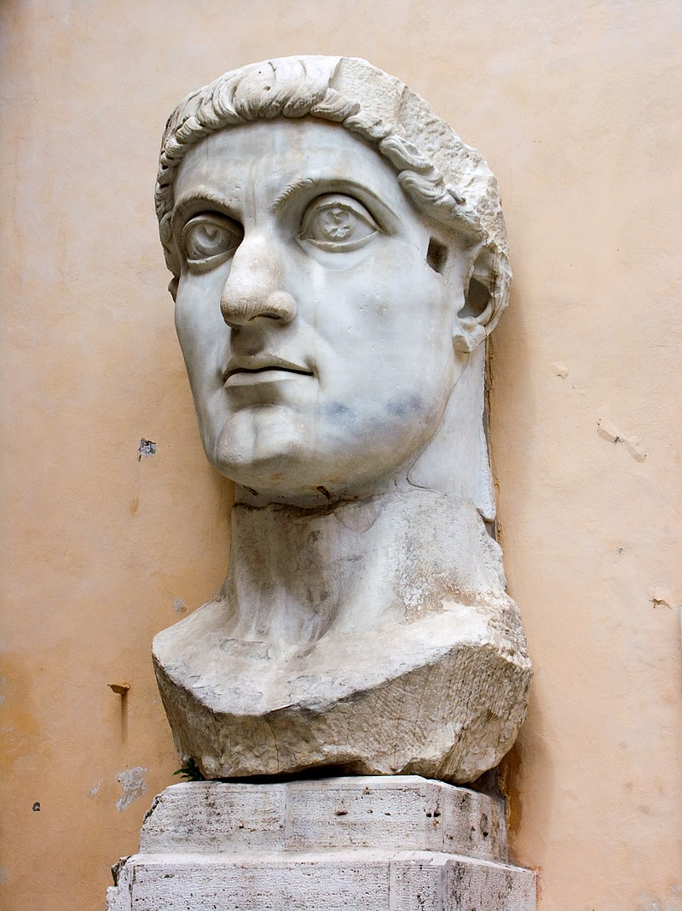
Constantine
Faithful Then, Faithful Now

Slide 10
Church Councils
Nicaea - 325
Constantinople - 381
Ephesus - 431
Chalcedon - 451
Creed of Nicaea
Condemns Arianism
Jesus is the same substance as the Father
Nicene Creed
Holy Spirit is God
God is one essence, three persons
Condemns Nestorianism, Pelagianism
Christ is one person with two natures
Condemns Eutychianism, Apollinarianism
Two natures of Christ affirmed
Christ is fully God and fully man
Faithful Then, Faithful Now

Slide 11
FAITHFUL THEN, FAITHFUL NOW
God’s Work throughout Church History

